Slide 1
Interactive Learning Session
Please download Seesaw: The Learning Journal
or go to app.seesaw.me
Notes:
PD Presentation begins here.

Slide 2
Hello!
😊
I am Alwyn McRandle
I am here because I love working with Seesaw.
You can find me at alwynmcrandle@rnls.school.nz

Slide 3
Today’s Agenda and Goals
App Smashes?
Experiment with Chatterpix
Classroom Ideas and Examples
Activities
Explore Library and upload
Parent App tips
Ideas/Questions

Slide 4
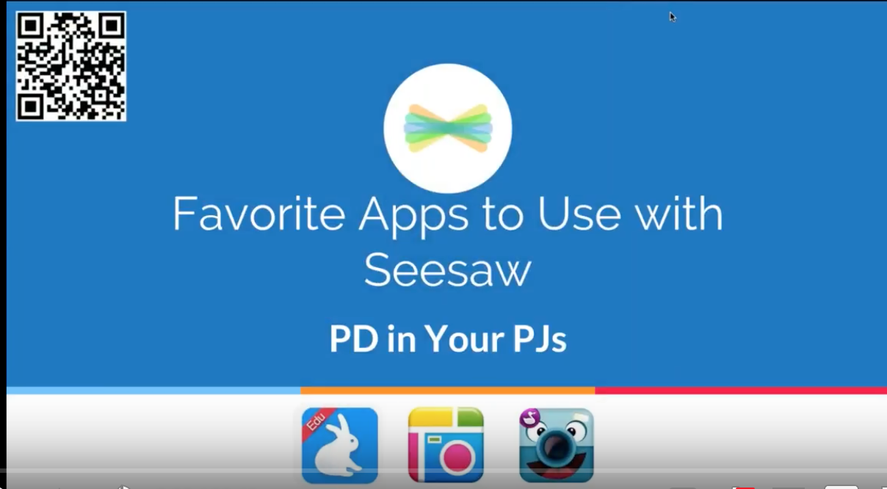
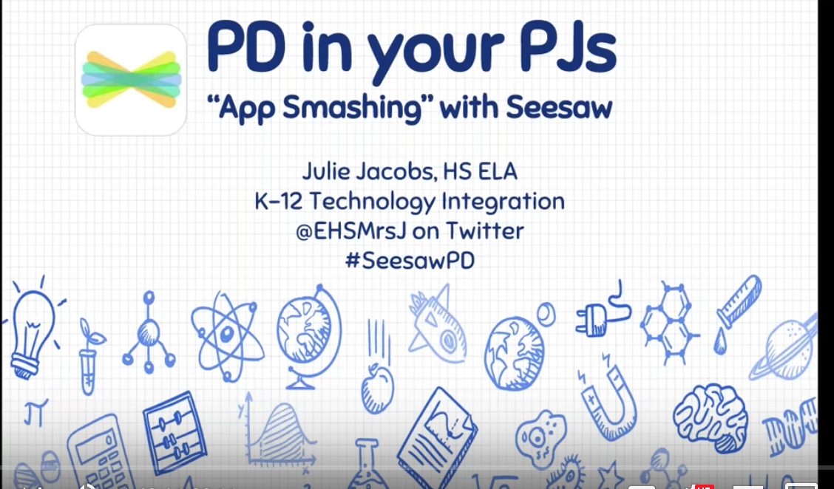
What is App smashing?
The process of using multiple apps in conjunction with one another to complete a final task or project.
~Greg Kulowiec (2013)
@gregkulowiec
Click
to
view
Click
to
view
Click to view

Slide 5
Helpful Hints
Always look for tools that save pictures and videos to the Camera Roll of the device...
Never underestimate the power of a screenshot!
A good formula for app smashing
+

Slide 6
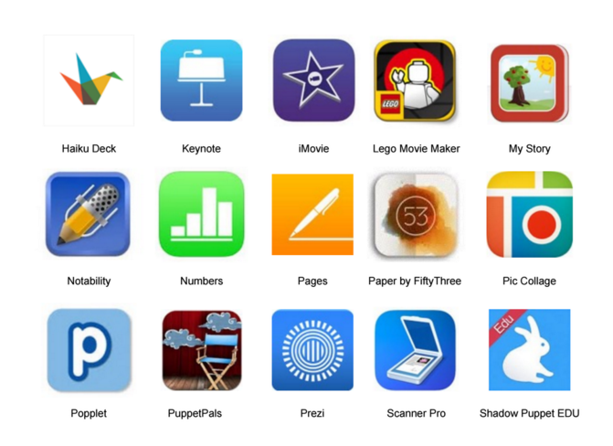
Time Saving Tip
Save digital creations from many apps into Seesaw.
Photos, videos, links, PDFs—all go into Seesaw!
See a list compatible apps here

Slide 7
Experience
as a Student
Grab a device & get ready to appsmash

Slide 8
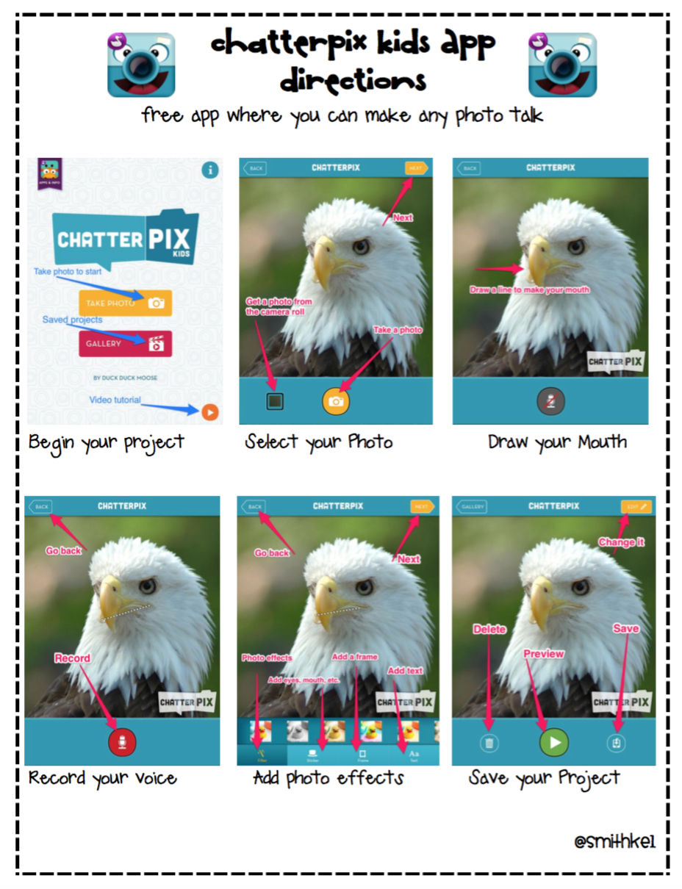
Let’s look at Chatterpix

Slide 9
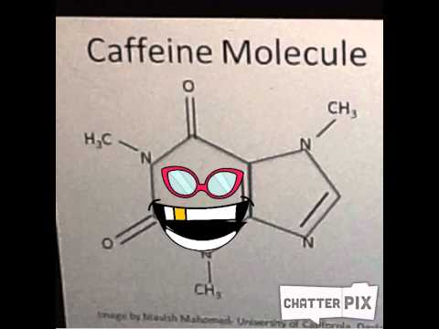
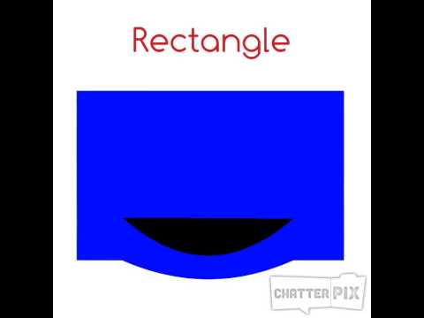
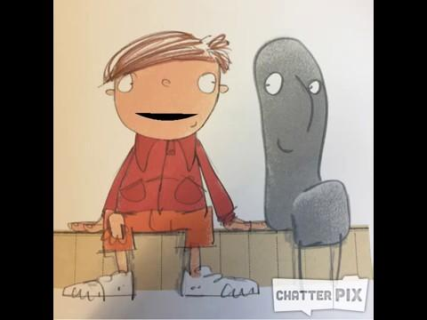

Slide 10
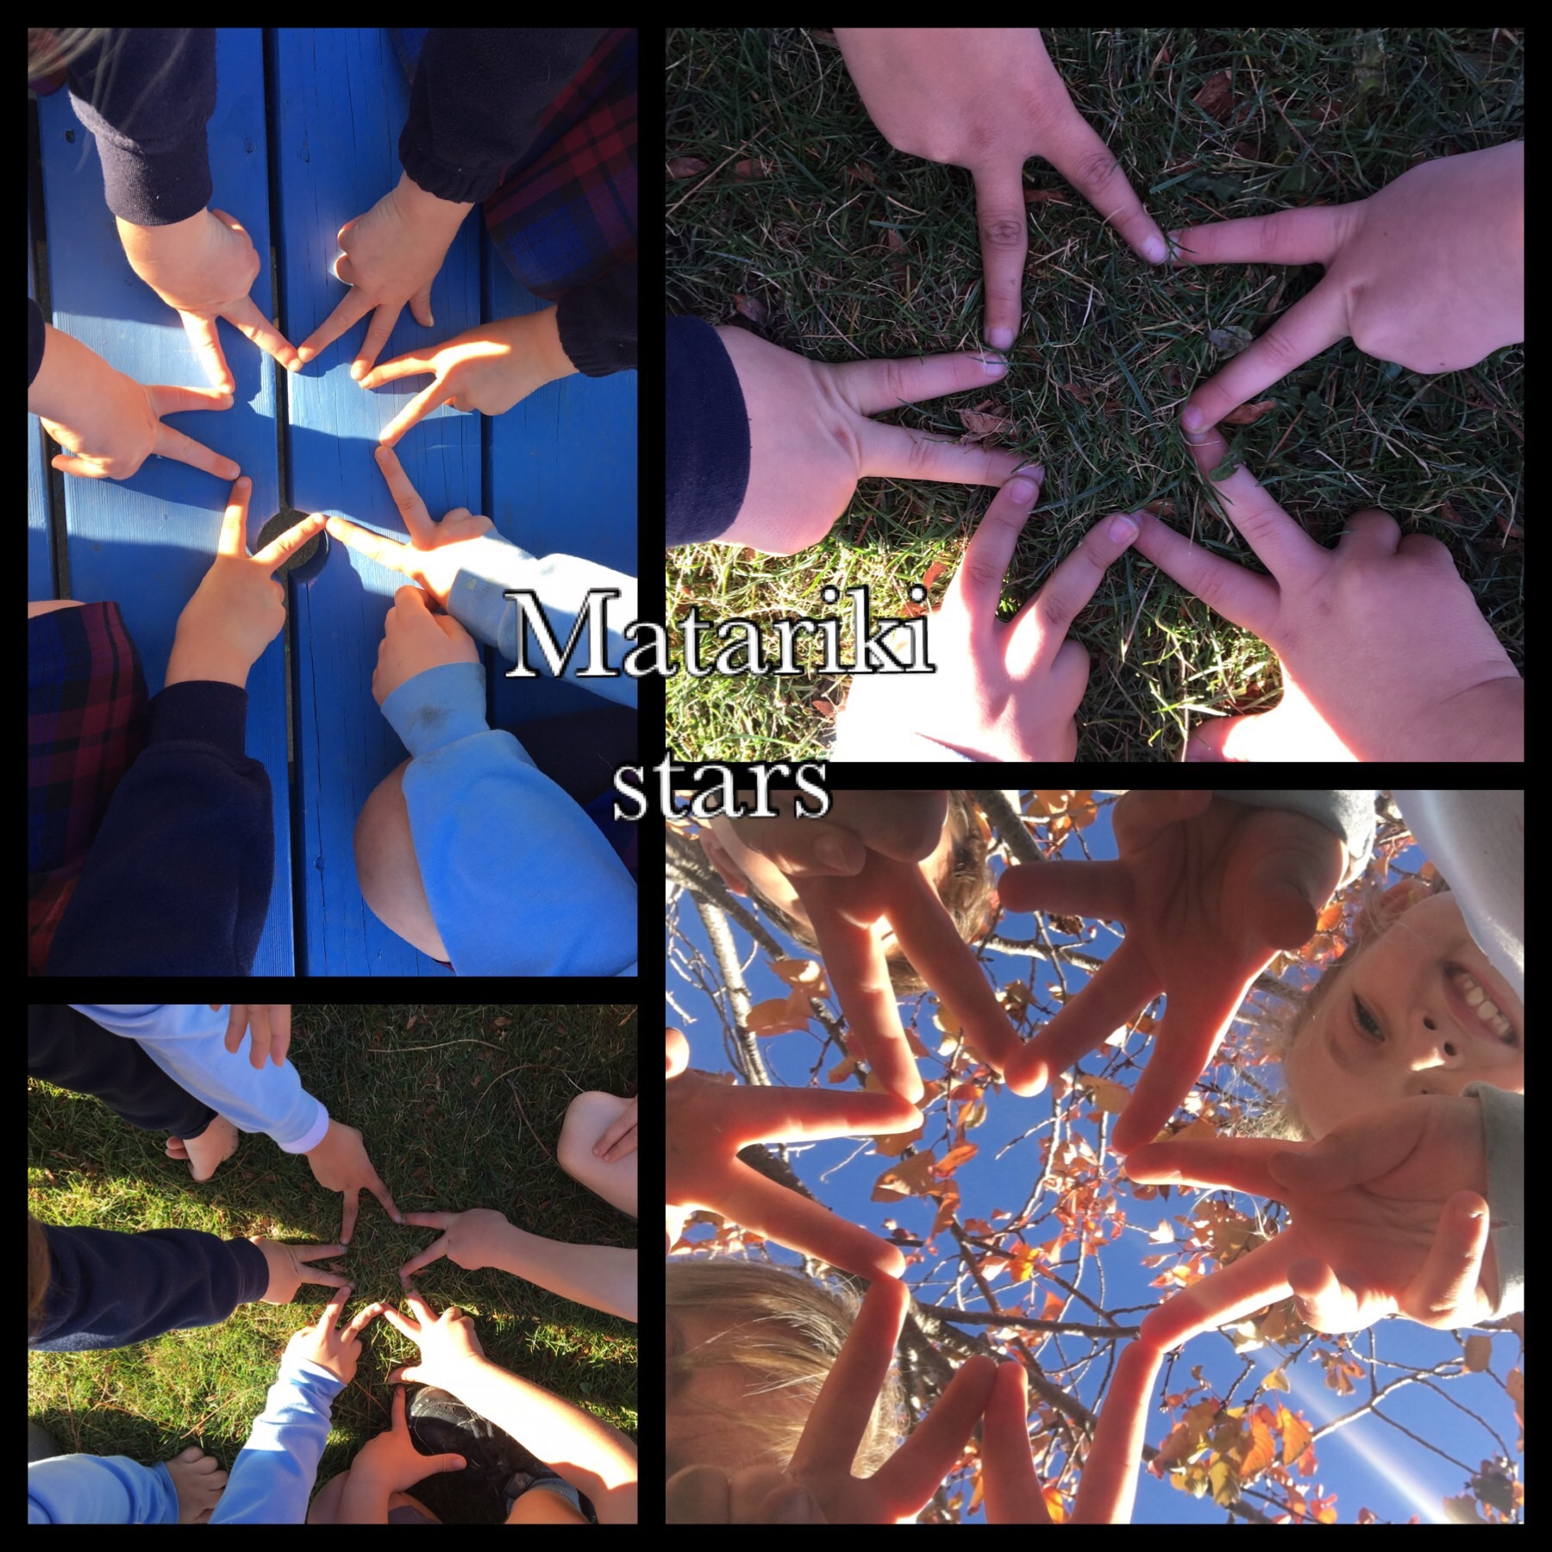
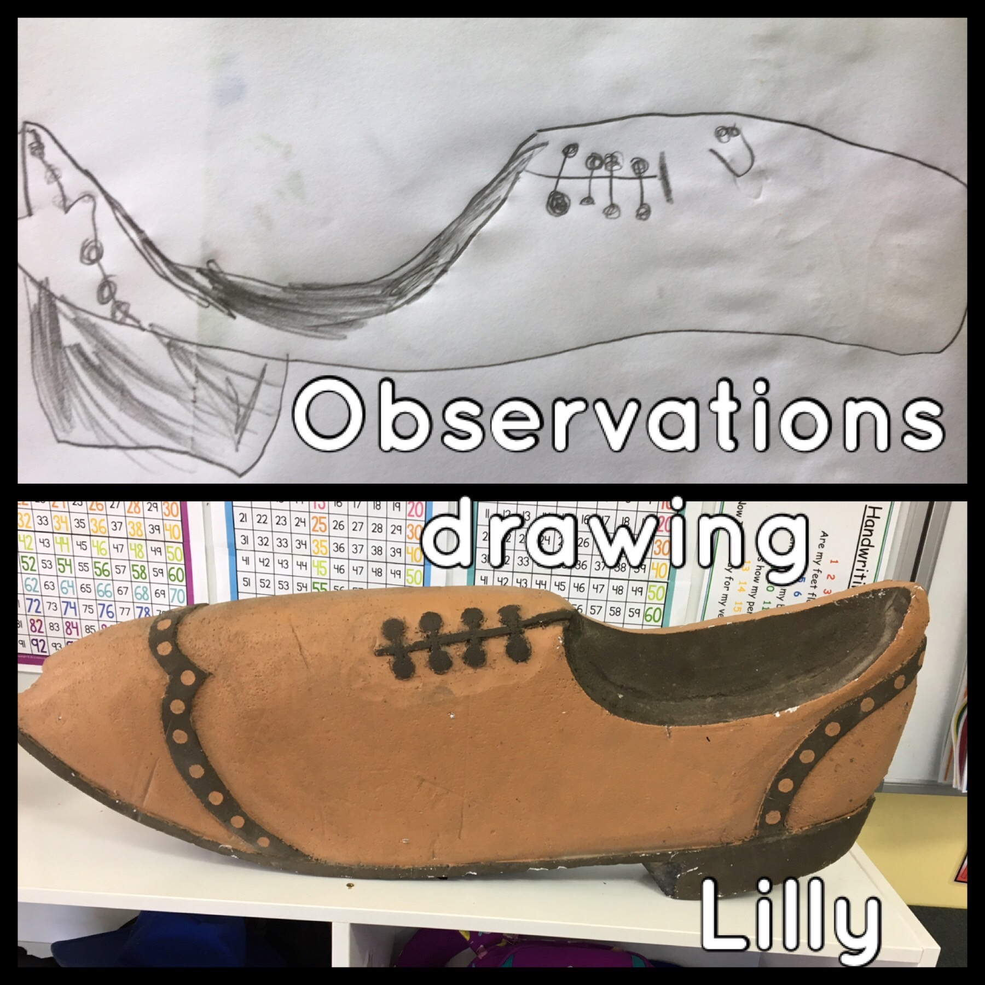
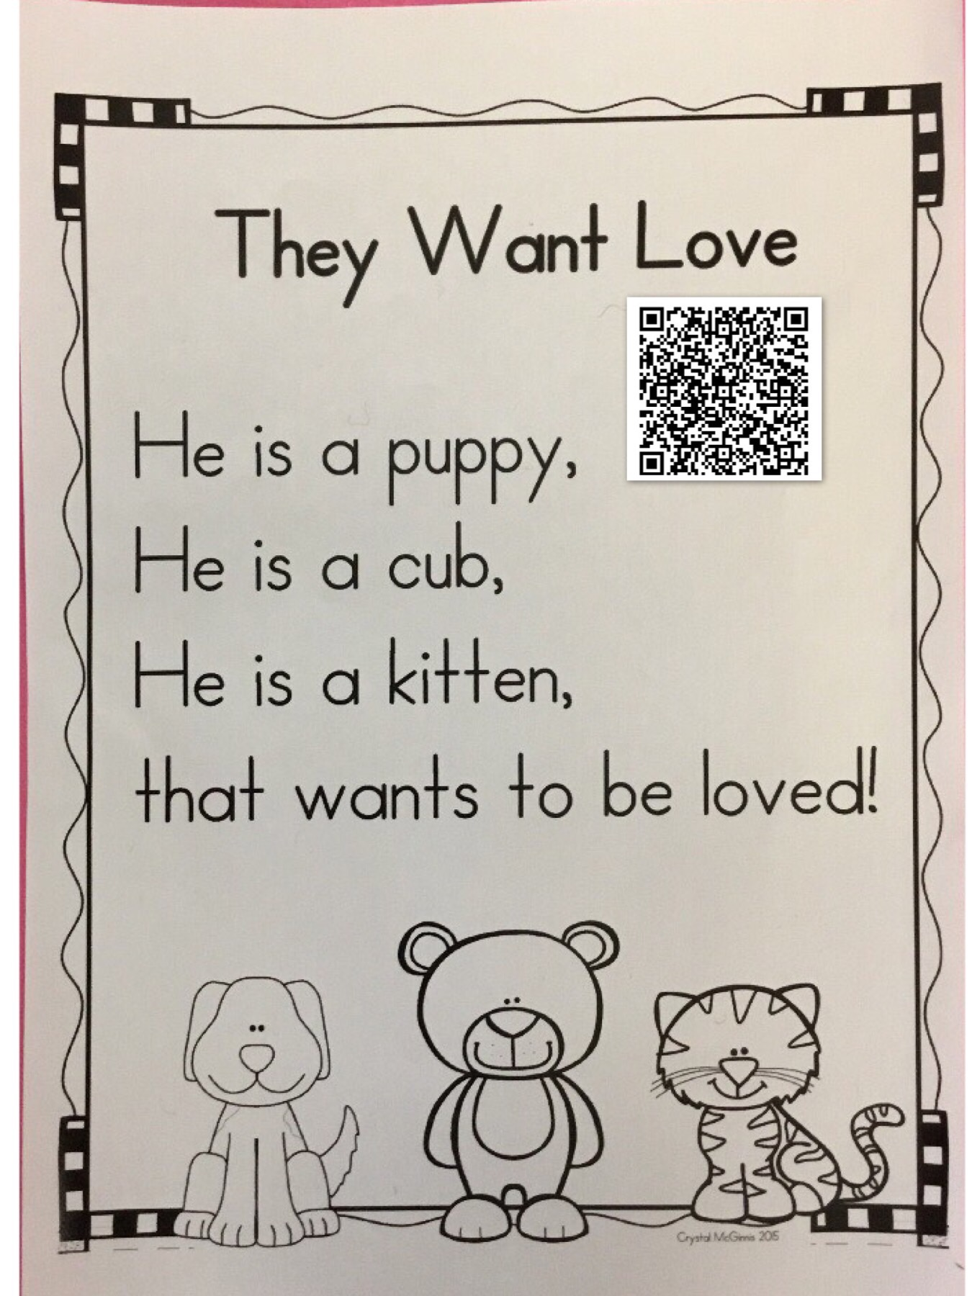
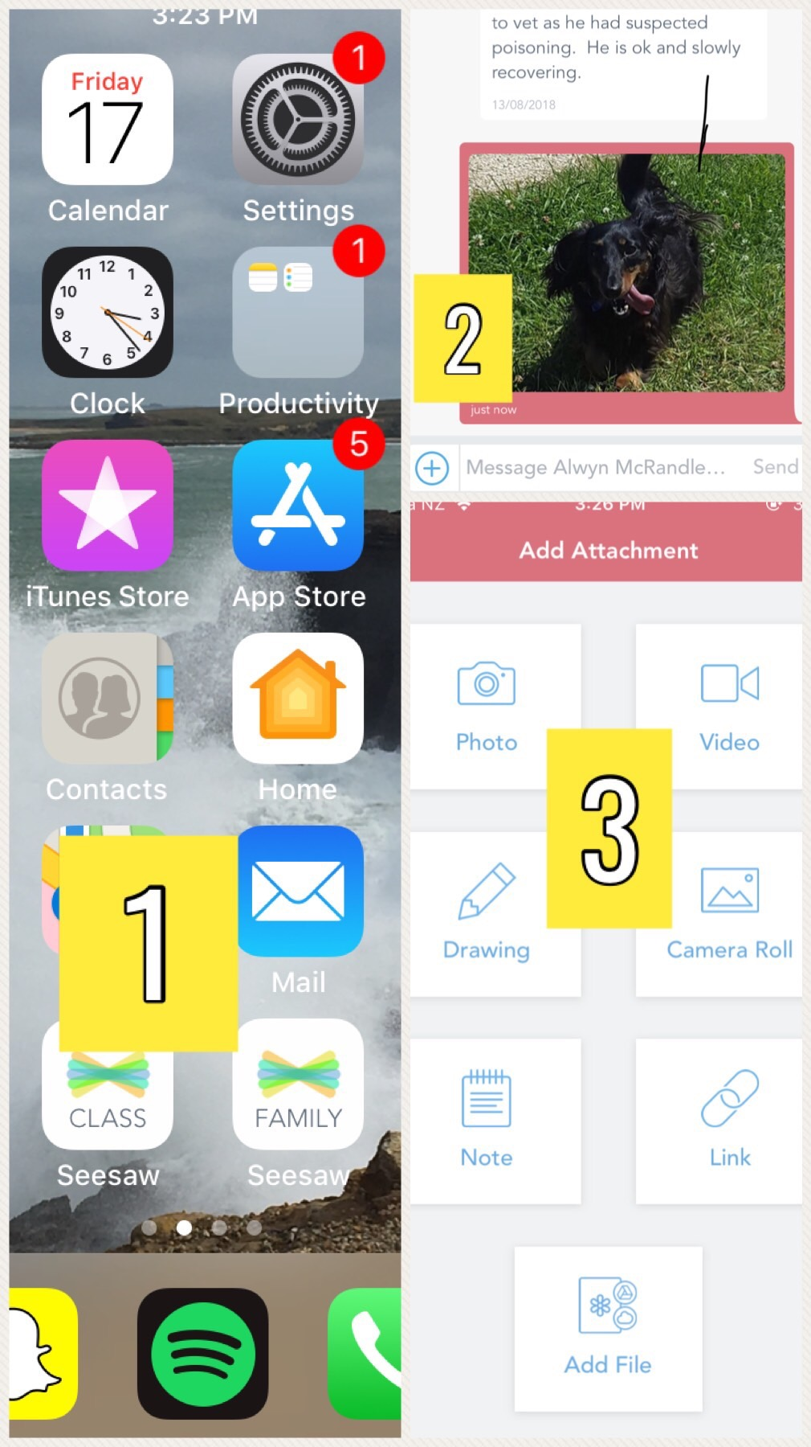
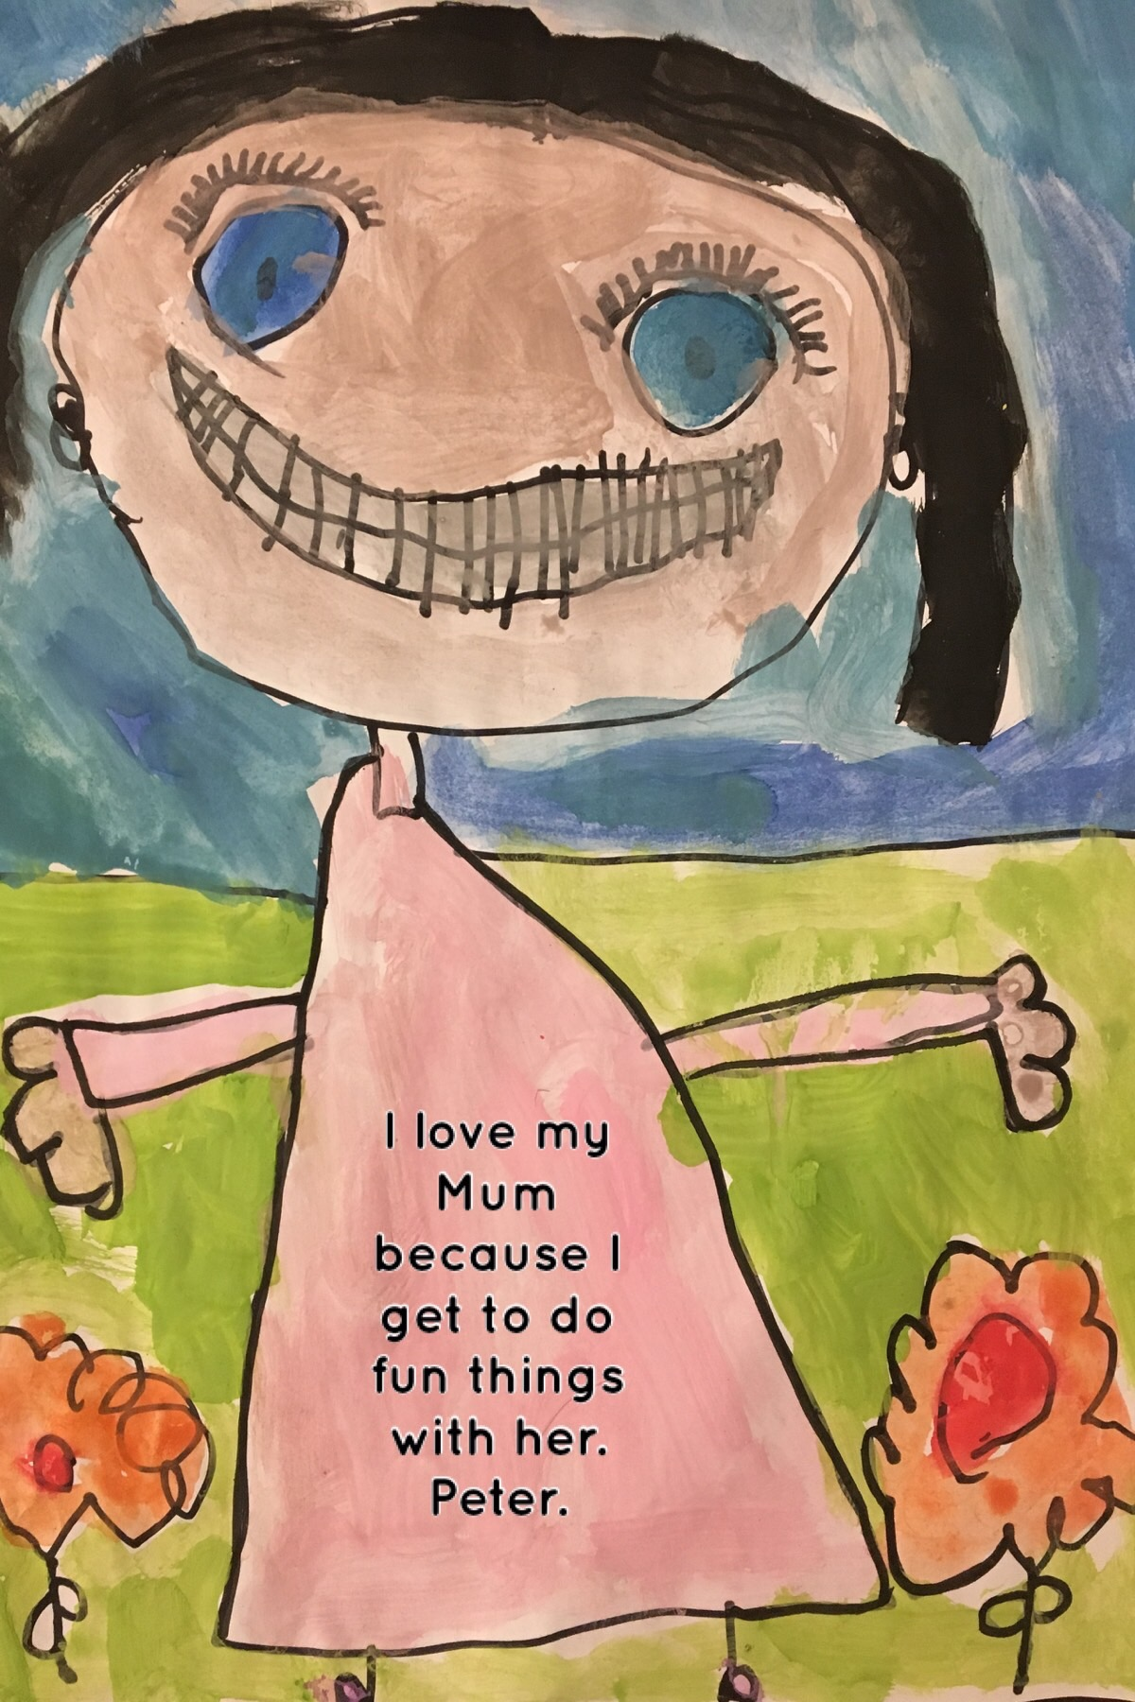
Pic Collage
Ideas
Book snaps
Vocab Snaps
Posters
Facts Info sheet
Blends Poster
Maths Concepts
Newsletters
Art
Sequencing
Step by step
instructions

Slide 11
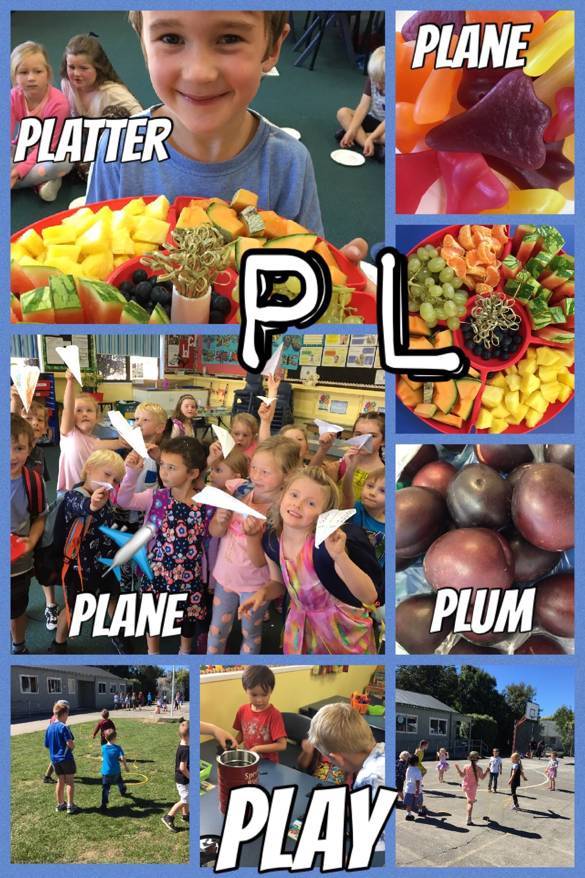
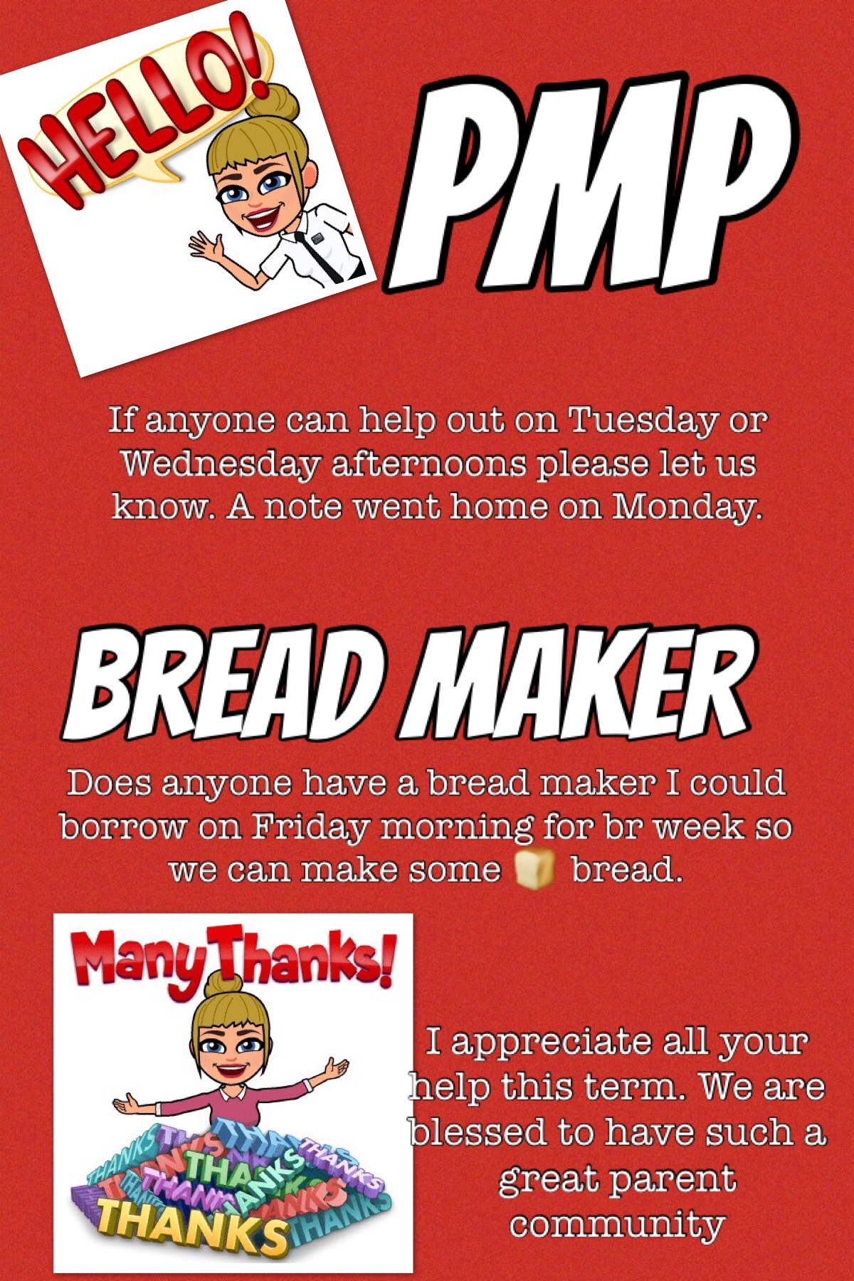
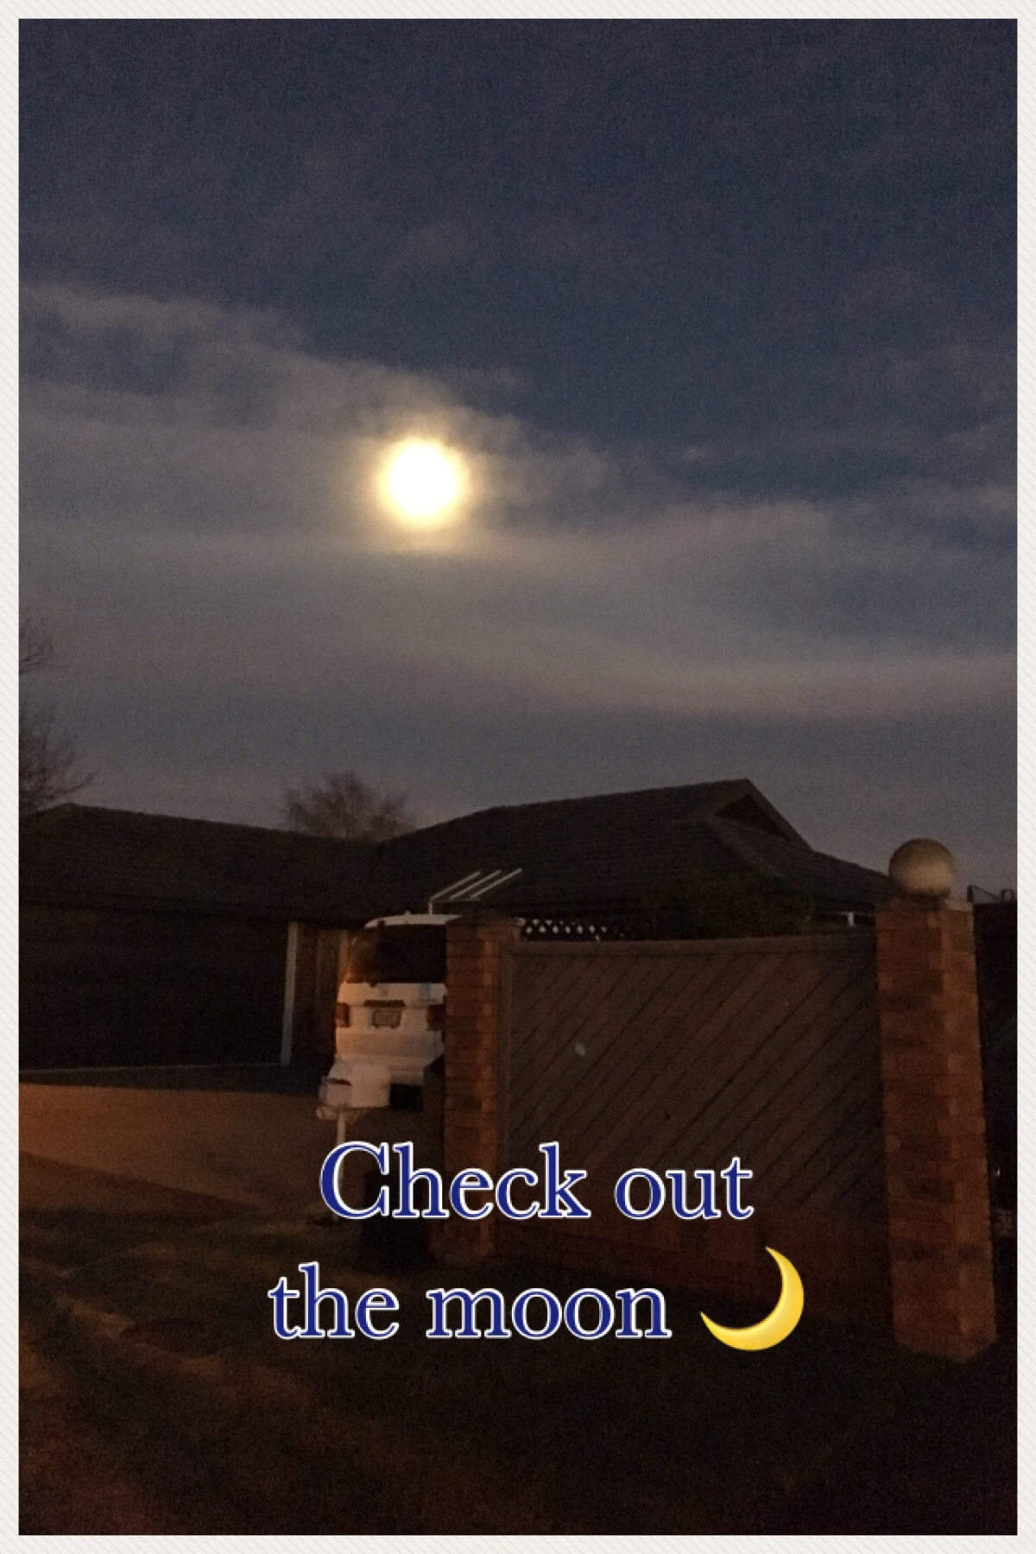
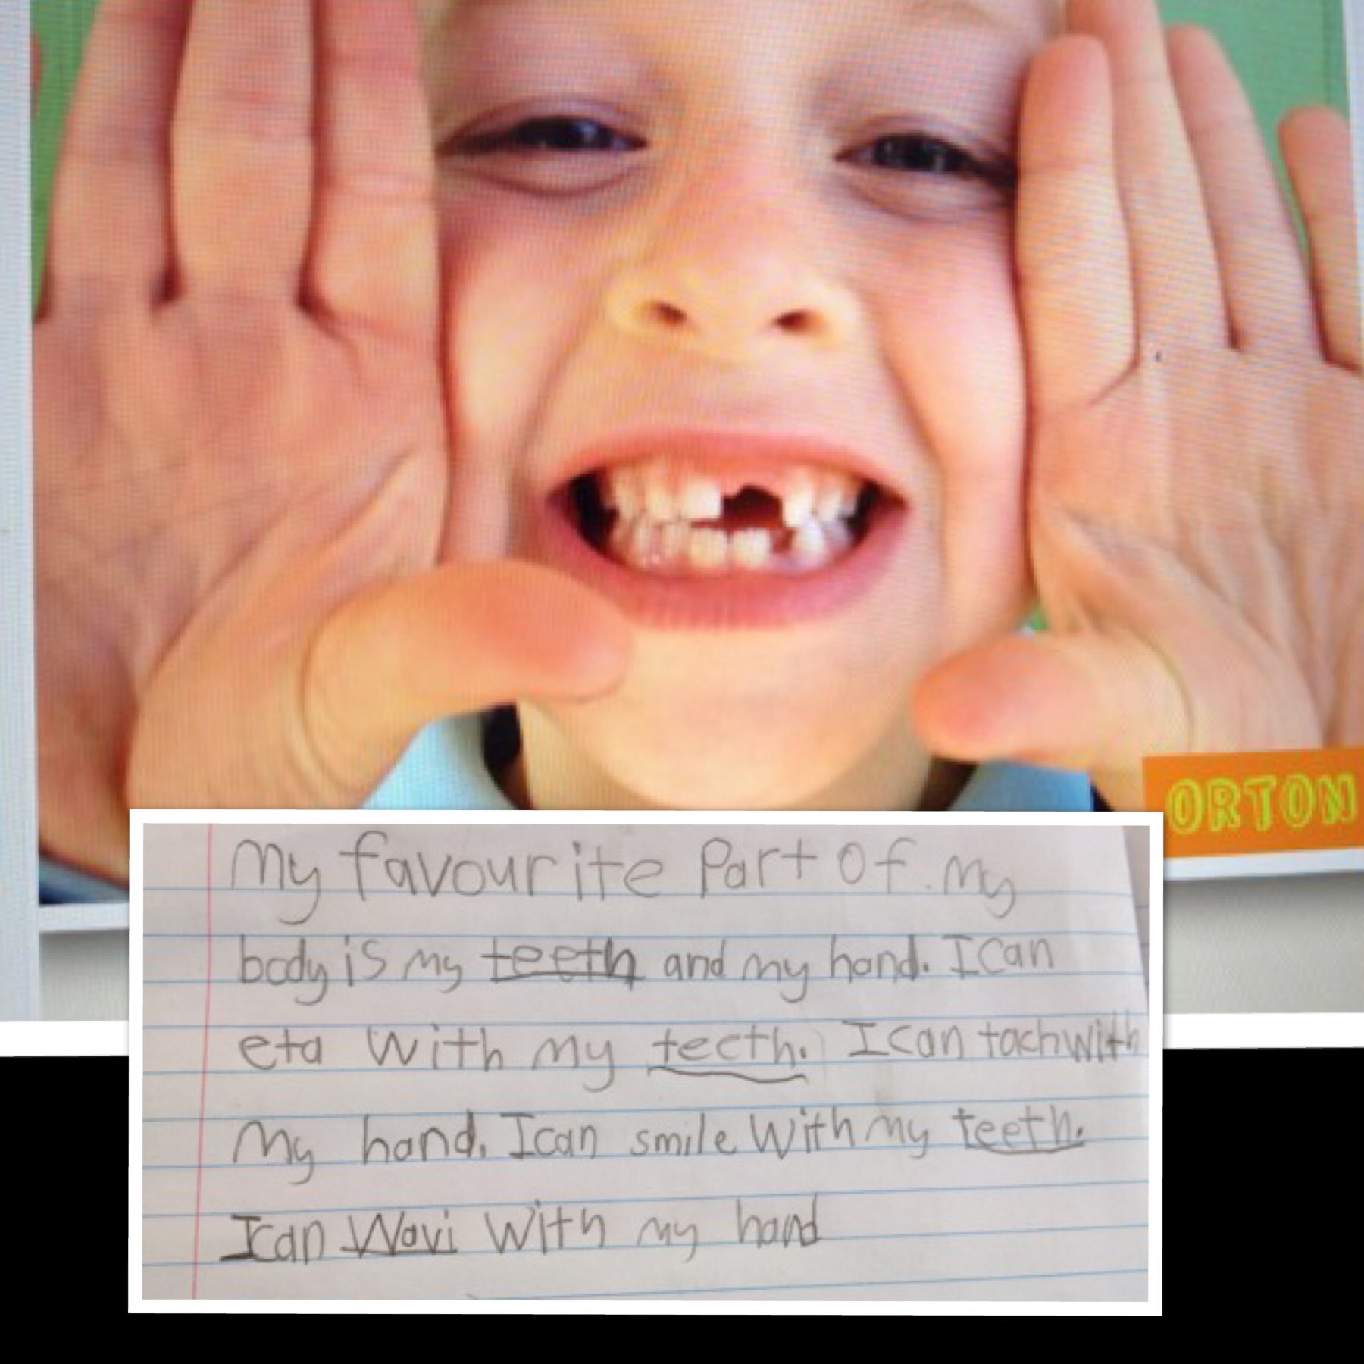
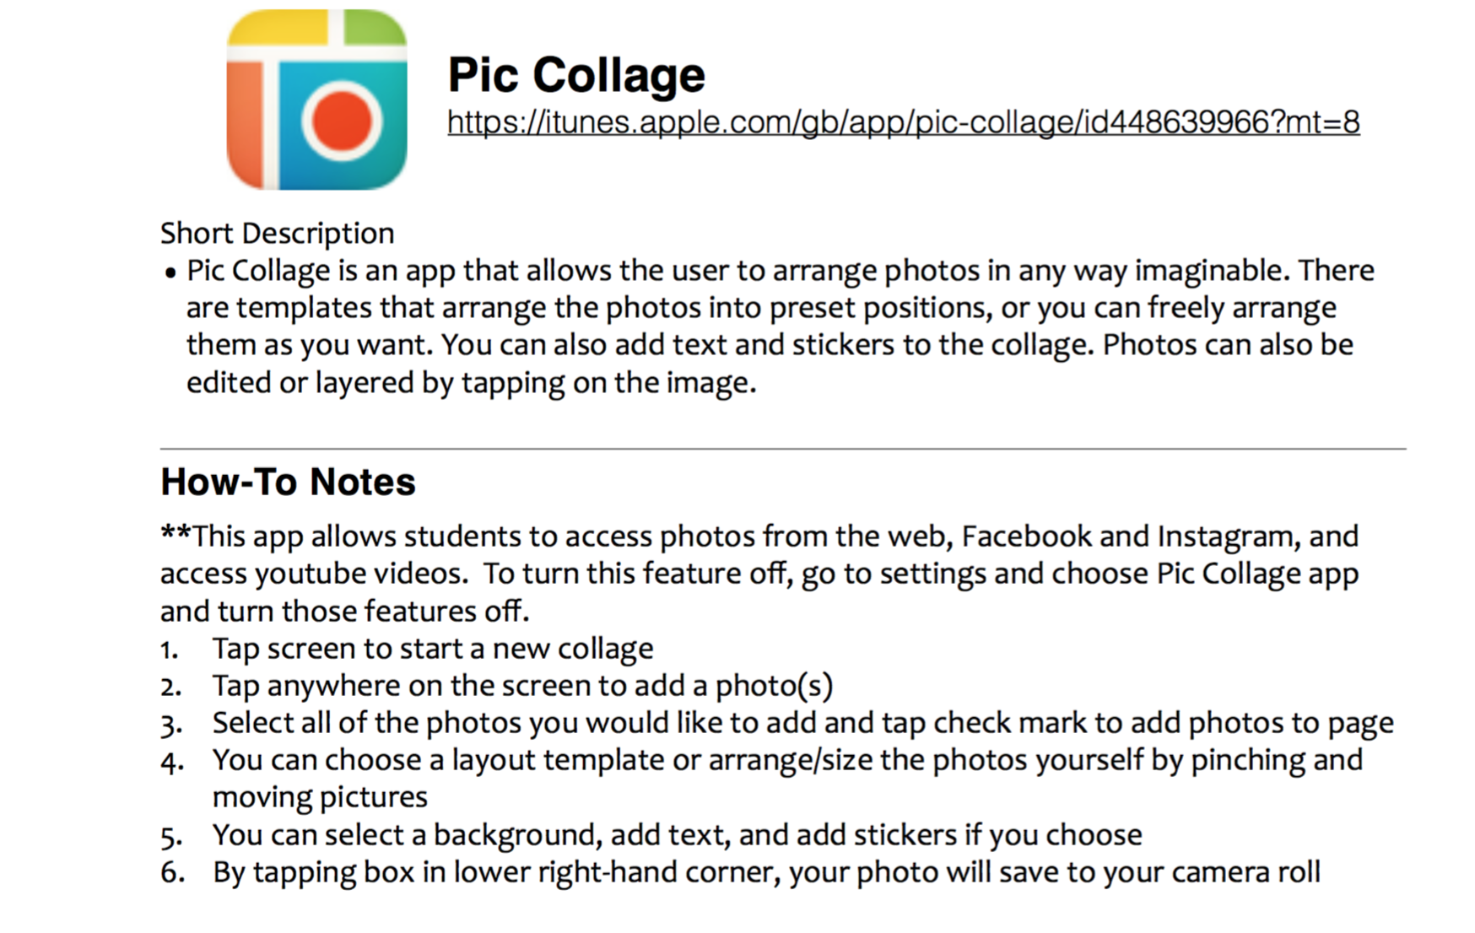
Pic Collage

Slide 12
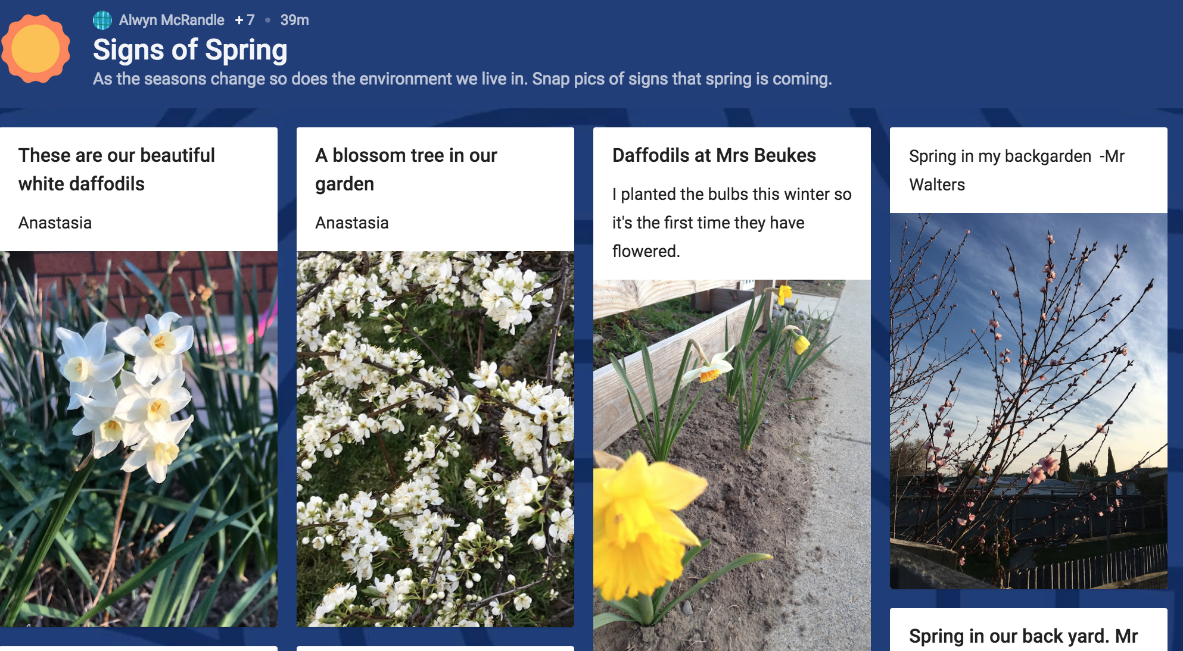
Padlet

Slide 13
Activities

Slide 14
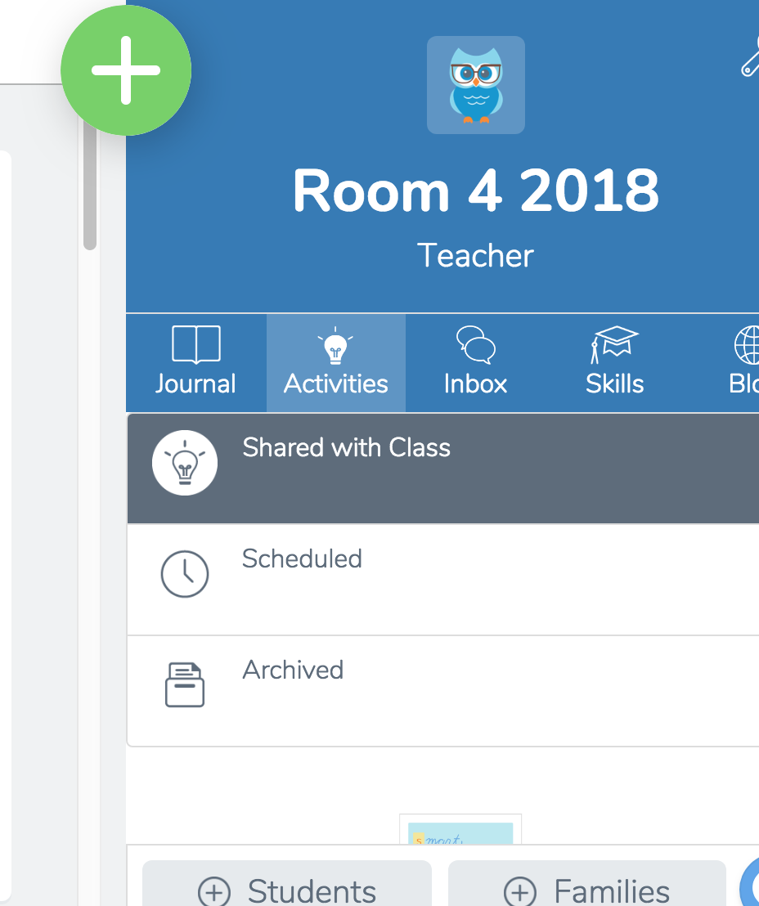
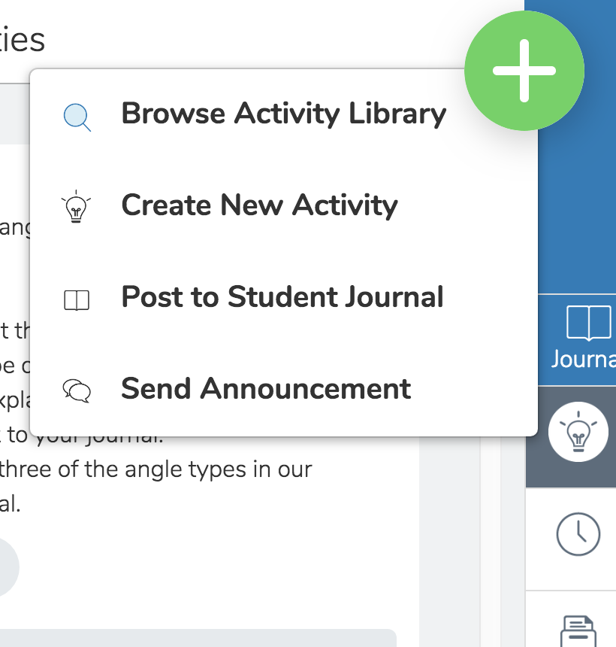
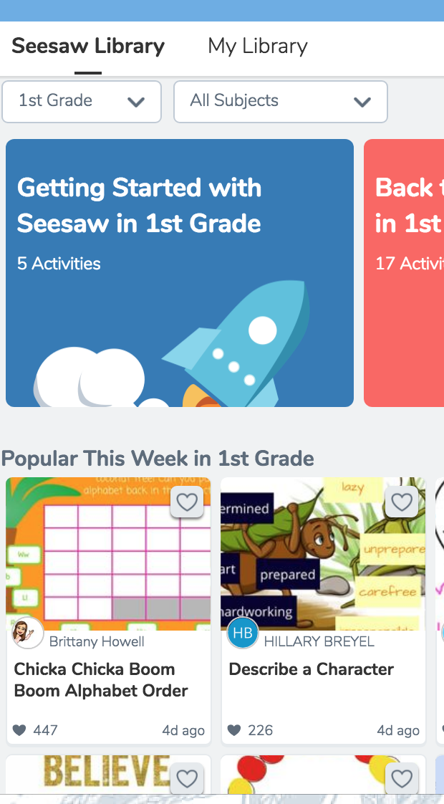
1
2
3
4
1

Slide 15
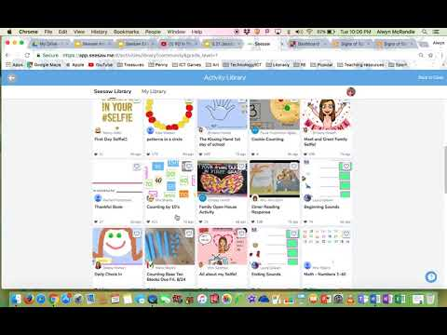
Add an activity to our class page

Slide 16
Go into activities and complete the task.
Awesome job!
Note: You can only add tasks as the teacher.

Slide 17
Flipped Learning Opportunities
Tip have the family app on your phone
In messengers on the family app all the Seesaw functions are available
Video here
Younger Students
Family App
Single sign in
*Add videos
*Activities
*Challenges to students journal
*they can engage with these at home
Notes:
If you do not want teachers to change any class settings, remove this slide.

Slide 18
Connect with other teachers using Seesaw
Follow @Seesaw on Twitter
Check out the “Seesaw Teachers” group on Facebook
Go to help.seesaw.me for resources
Contact me as well!
Thank You!

Slide 19
More Student Examples to Browse Later

Slide 20
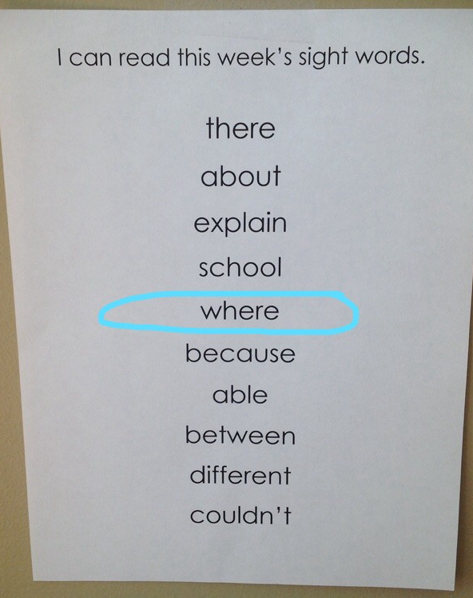
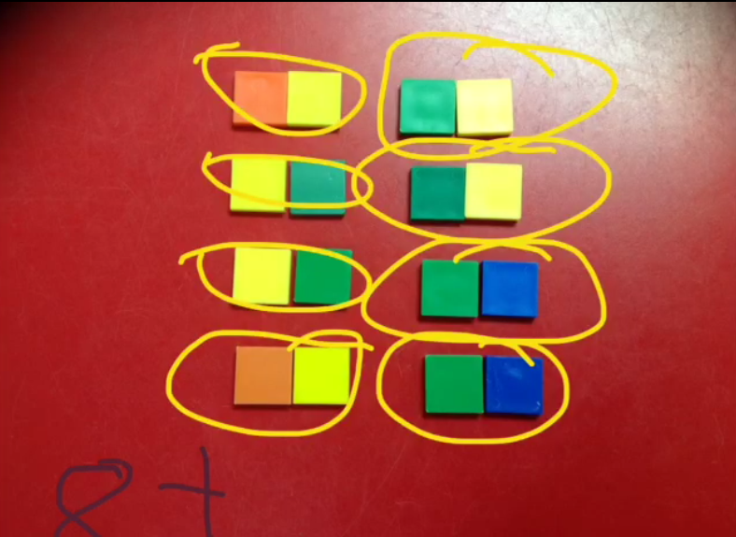
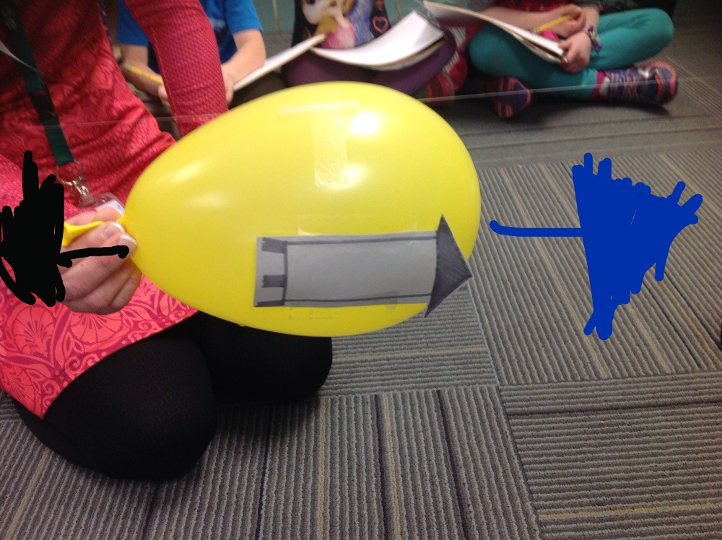
Student Samples from Kindergarten - 2nd
ELA: Words that rhyme
ELA: Flip instruction
ELA: Retelling a story
ELA: Letter recognition
Math: Odd and even numbers
Math: 3D shape hunt
Math: Making numbers
Science: Melting ice
Science: Newton’s laws of motion
Assessment: Sight words
Assessment: Oral counting

Slide 21
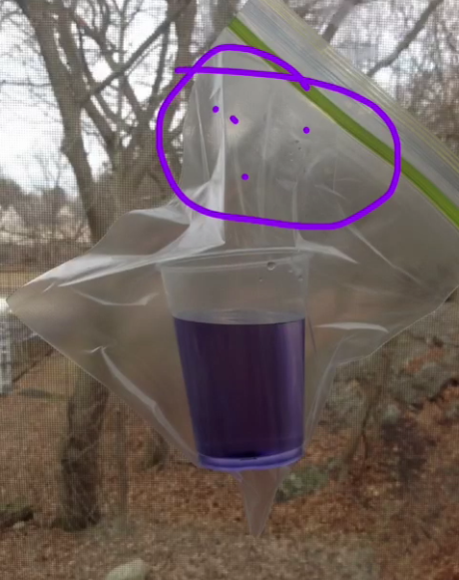
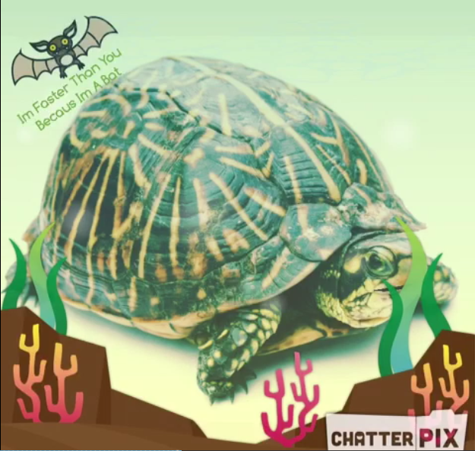
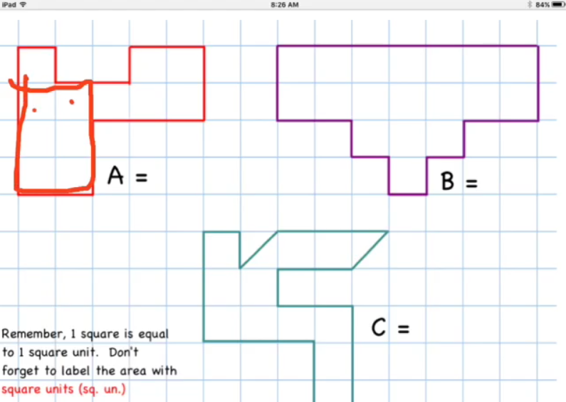
Student Samples from 3rd - 5th Grade
ELA: Reading summary
ELA: Spelling rules
ELA: Synonyms
Math: Equivalent fractions
Math: Finding area of a polygon
Science: Weather predictions
Science: Groundhog predictions

Slide 22
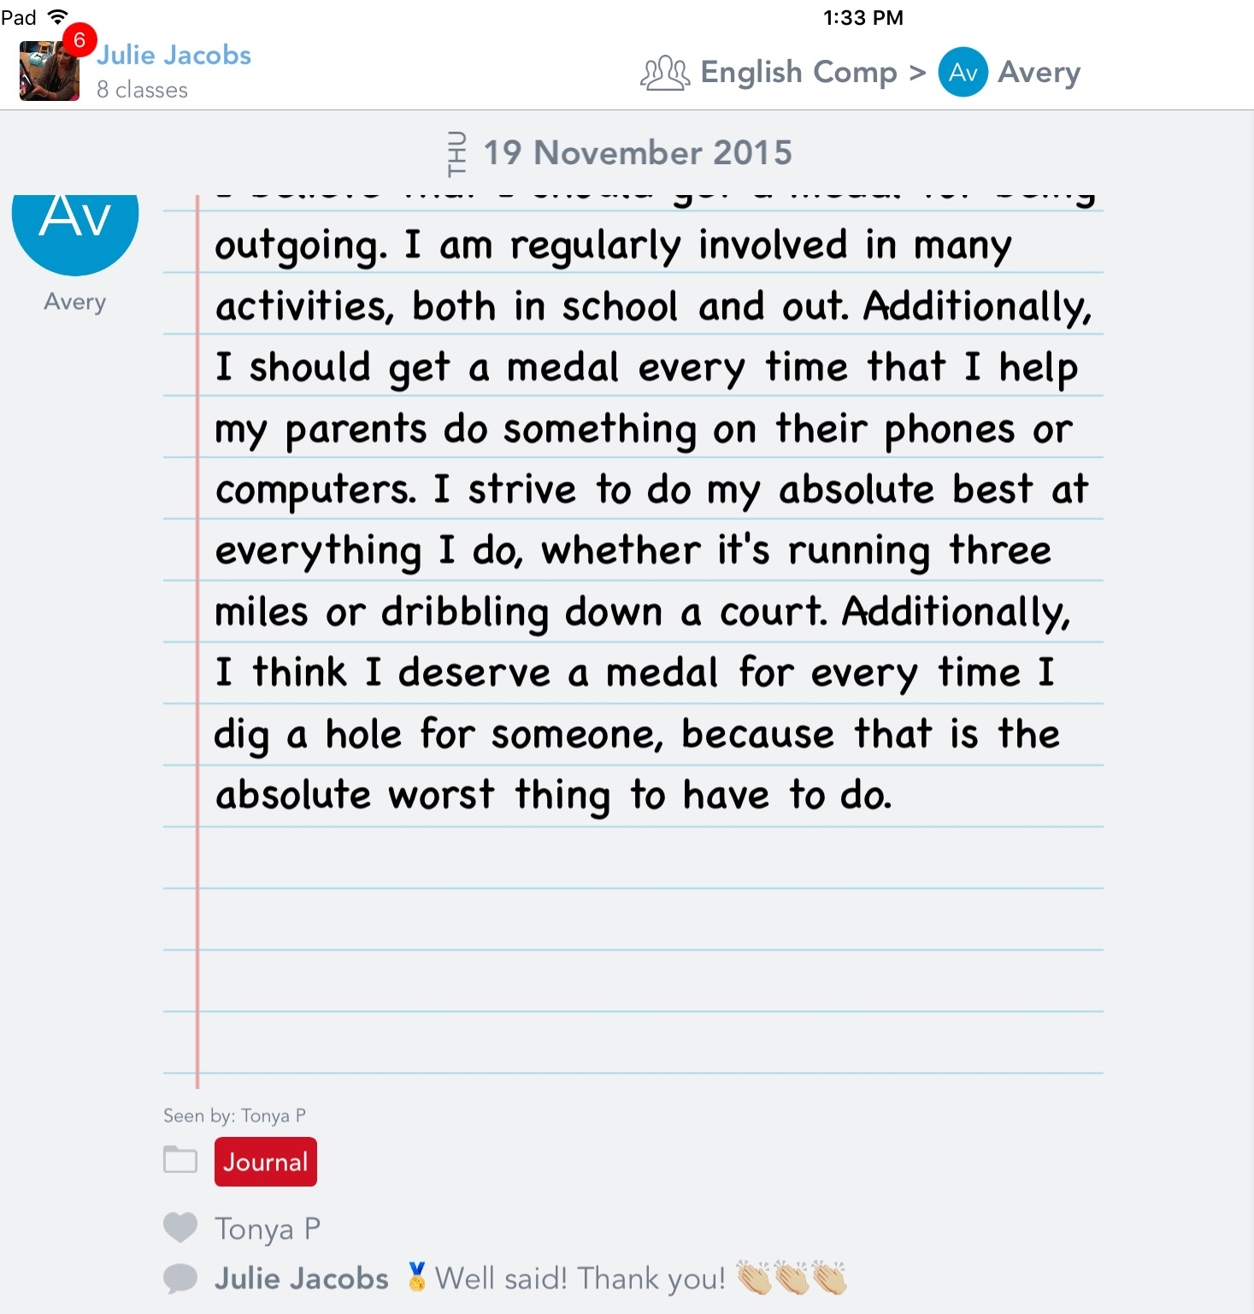
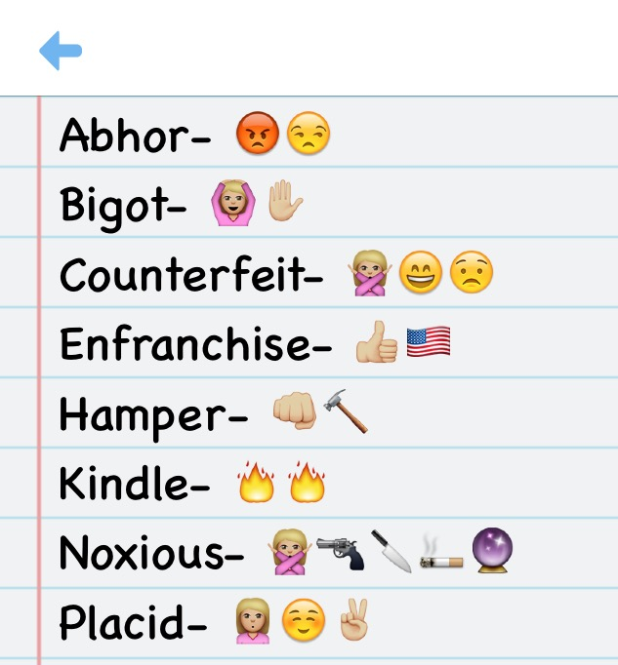
Student Samples from Middle & High School
English: InfoPics
English: Book Mosaics
Emoji Vocab (right)
Writing Portfolio (right)
Speech: Visual Aids for Speeches/Presentations
History: Character/Historical Figure ChatterVids

Slide 23
Credits
Presentation template by SlidesCarnival

